Slide 1


Slide 2

9
POSSIBILITIES, PREFERENCES,
AND CHOICES

Slide 3
After studying Chapter 9 you will be able to
Describe a household’s budget line and show how it changes when prices or income change
Use indifference curves to map preferences and explain the principle of diminishing marginal rate of substitution
Predict the effects of changes in prices and income on consumption choices
Copyright © 2013 Pearson Canada Inc., Toronto, Ontario

Slide 4
Consumption Choices
  The choices you make as a buyer of goods and services is influenced by many factors, which economists summarize as
  Consumption possibilities
  Preferences
Consumption Possibilities
  Consumption possibilities are all the things that you can afford to buy.
Copyright © 2013 Pearson Canada Inc., Toronto, Ontario

Slide 5
Consumption Choices
  We’ll study the consumption possibilities of Lisa, who buys only two goods: movies and pop.
  A Consumer’s Budget Line
  Consumption possibilities are limited by income, the price of a movie, and the price of pop.
  When Lisa spends all of her income, she reaches the limits of her consumption possibilities.
  Lisa’s budget line shows the limits of her consumption possibilities.
Copyright © 2013 Pearson Canada Inc., Toronto, Ontario

Slide 6
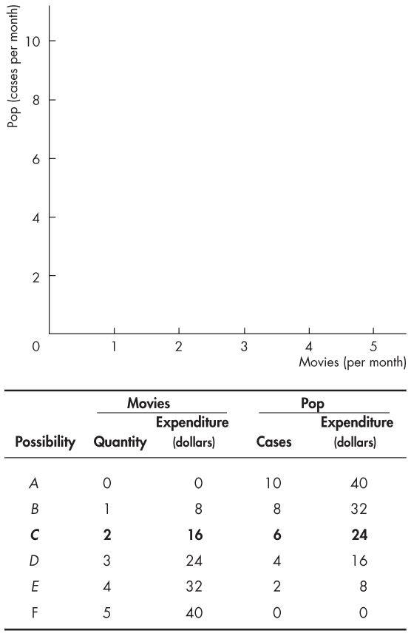

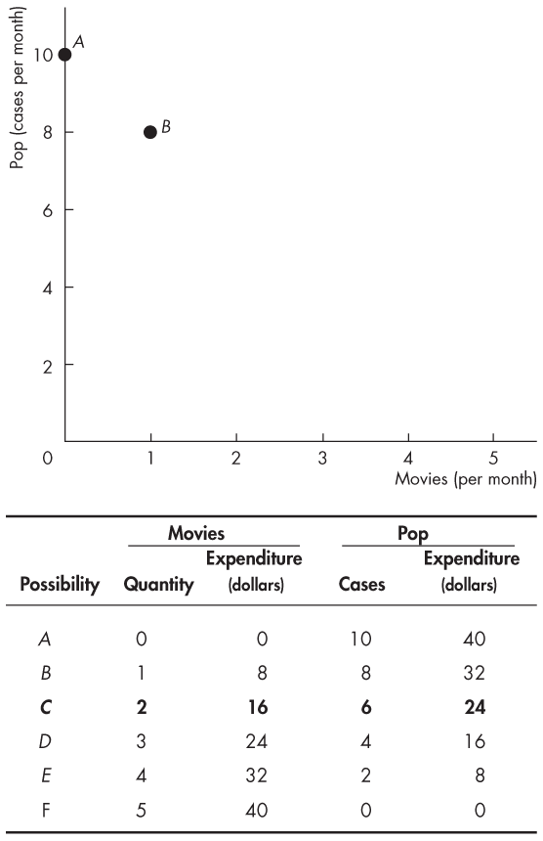
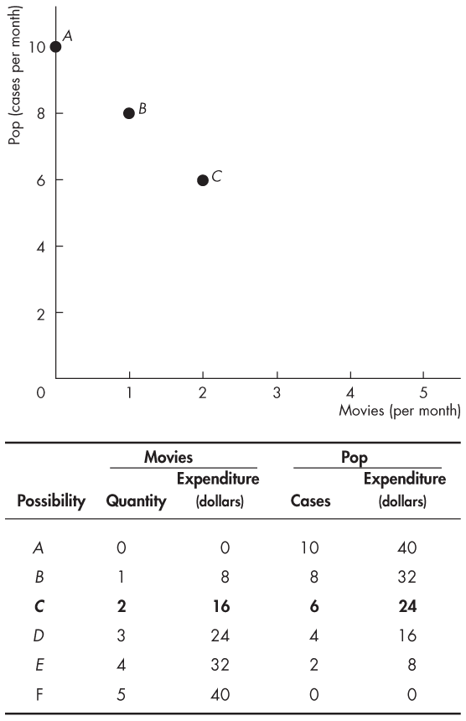
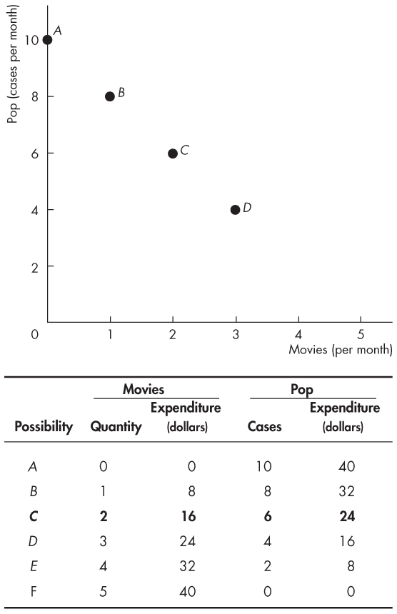
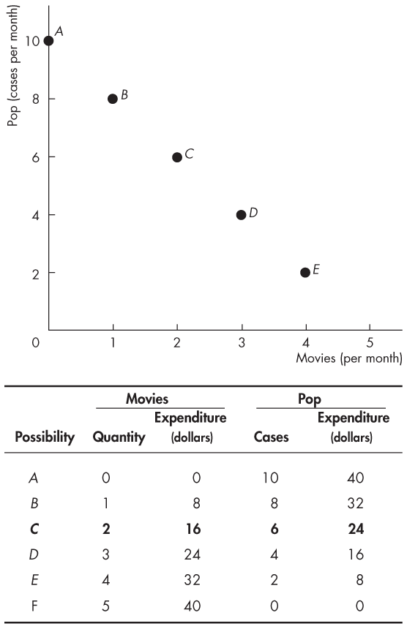

Consumption Possibilities
  Lisa has $40 to spend, the price of a movie is $8 and the price of pop is $4 a case.
  The table lists seven possible ways in which she can spend her $40.
  The graphs plots these combinations of movies and pop.
Copyright © 2013 Pearson Canada Inc., Toronto, Ontario

Slide 7
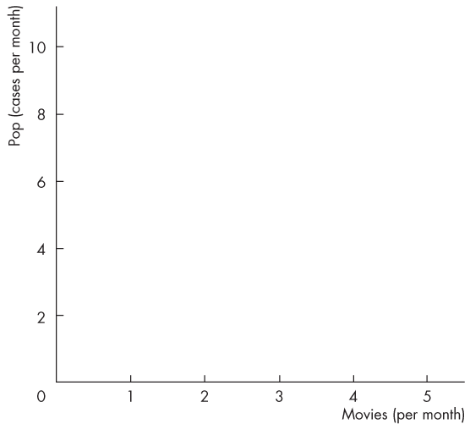
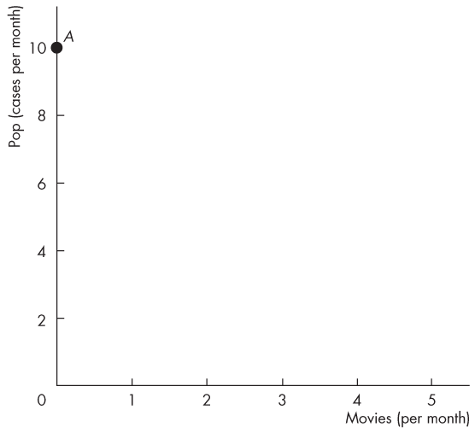
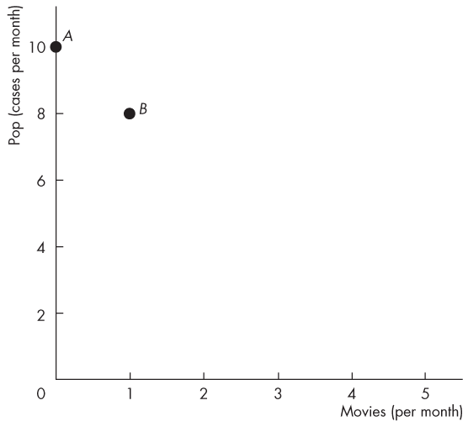
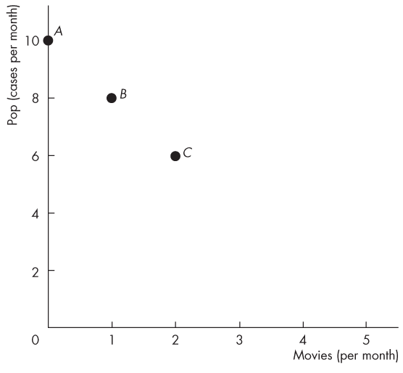
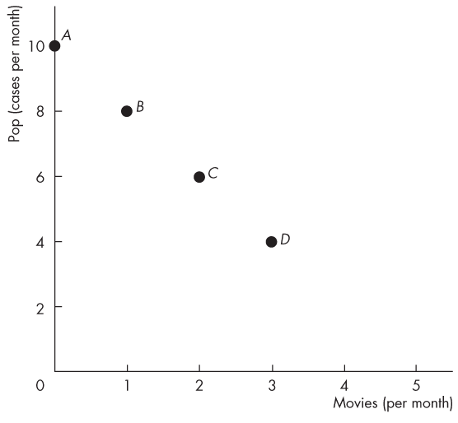
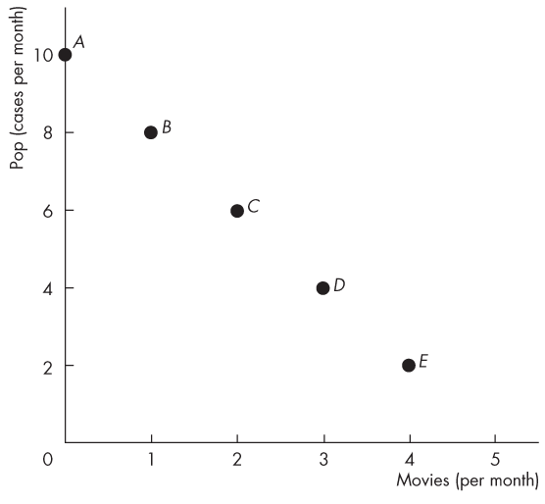
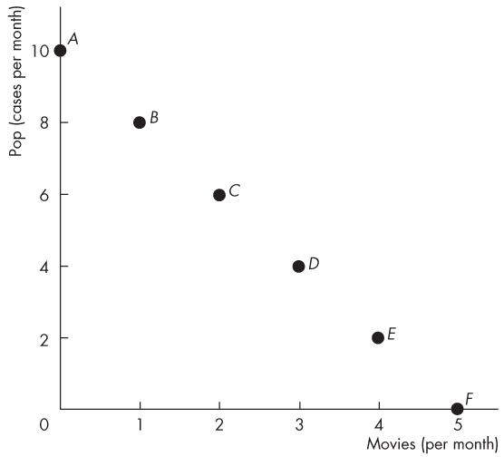
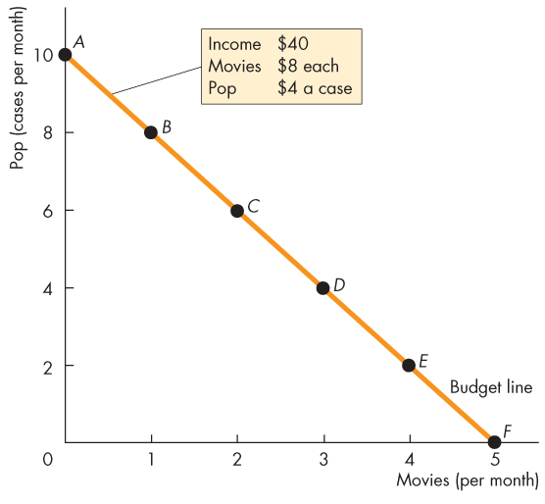
Consumption Possibilities
  Lisa can afford any of the combinations at the points A to F.
  Some goods are indivisible and must be bought in whole units at the points marked.
  Other goods are divisible goods and can be bought in any quantity.
  The line through points A to F is Lisa’s budget line.
Copyright © 2013 Pearson Canada Inc., Toronto, Ontario

Slide 8
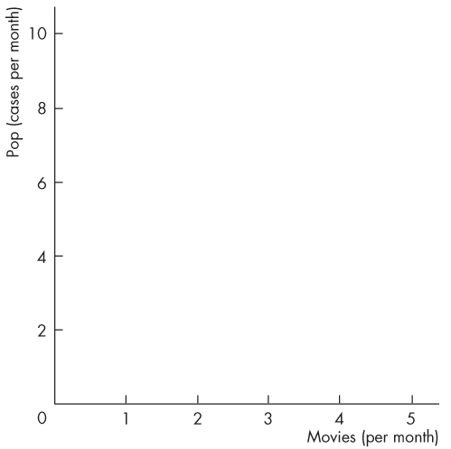
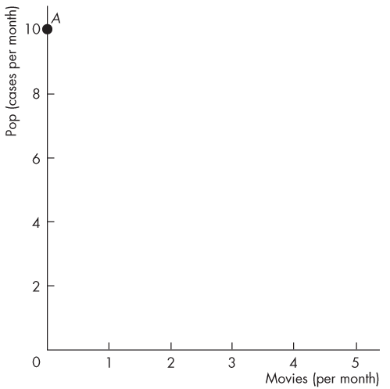
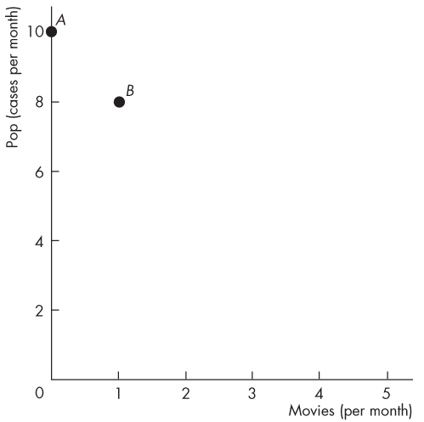
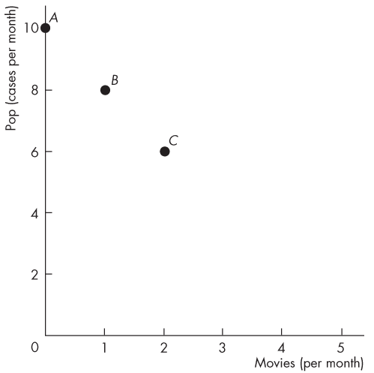
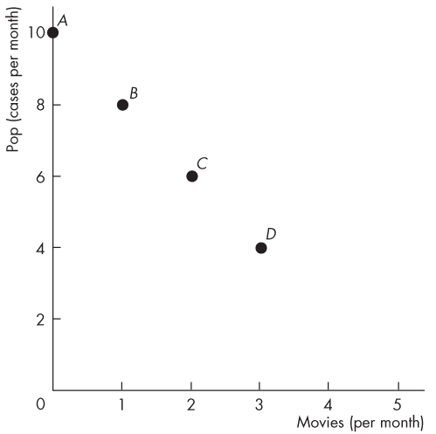
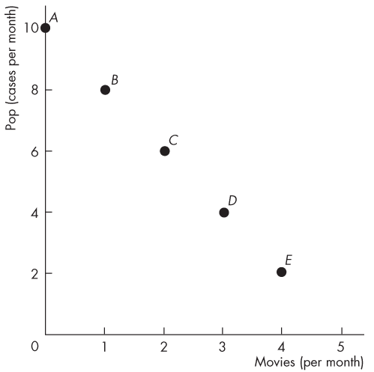
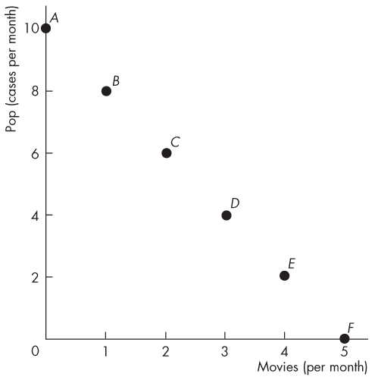
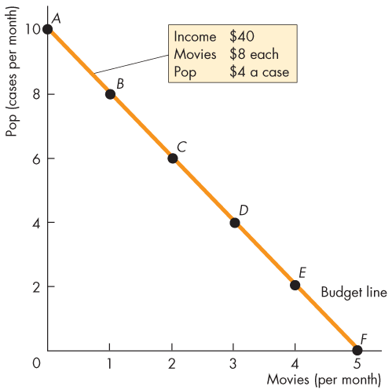
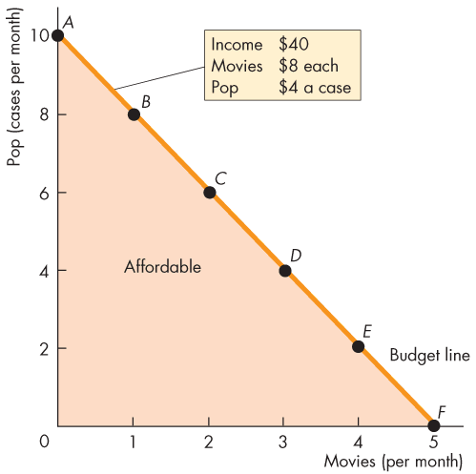
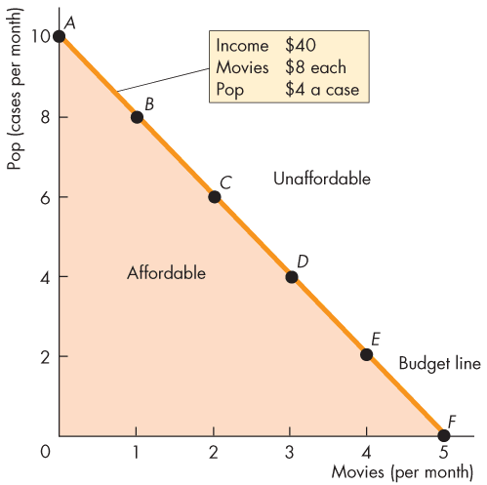
Consumption Possibilities
  The budget line is a constraint on Lisa’s consumption choices.
  Lisa can afford any point on her budget line or inside it.
  Lisa cannot afford any point outside her budget line.
Copyright © 2013 Pearson Canada Inc., Toronto, Ontario

Slide 9
Consumption Possibilities
The Budget Equation
  We can describe the budget line by using a budget equation.
  The budget equation states that
  Expenditure = Income
  Call the price of pop P_{P}, the quantity of pop Q_{P}, the price of a movie P_{M}, the quantity of movies Q_{M}, and income Y.
  Lisa’s budget equation is:
P_{P}Q_{P} + P_{M}Q_{M} = Y.

Slide 10
Consumption Possibilities
P_{P}Q_{P} + P_{M}Q_{M} = Y
Divide both sides of this equation by P_{P}, to give:
Q_{P} + (P_{M}/P_{P})Q_{M} = Y/P_{P}
Then subtract (P_{M}/P_{P})Q_{M} from both sides of the equation to give:
Q_{P} = Y/P_{P} – (P_{M}/P_{P})Q_{M}
Y/P_{P} is Lisa’s real income in terms of pop.
P_{M}/P_{P} is the relative price of a movie in terms of pop.

Slide 11
Consumption Possibilities
  A household’s real income is the income expressed as a quantity of goods the household can afford to buy.
  Lisa’s real income in terms of pop is the point on her budget line where it meets the y-axis.
  A relative price is the price of one good divided by the price of another good.
  Relative price is the magnitude of the slope of the budget line.
  The relative price shows how many cases of pop must be forgone to see an additional movie.

Slide 12
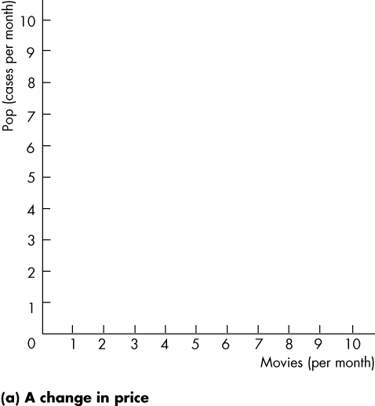
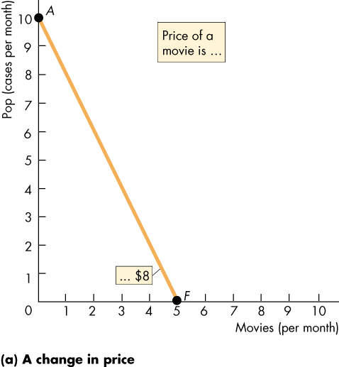
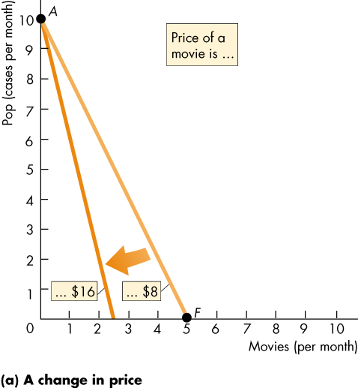
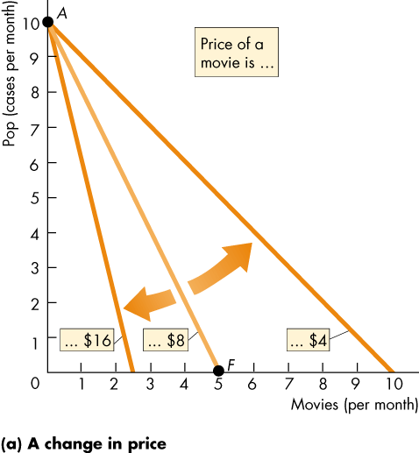
Consumption Possibilities
  A Change in Prices
  A rise in the price of the good on the x-axis decreases the maximum affordable quantity of that good and increases the slope of the budget line.
  Figure 9.2(a) shows the rotation of a budget line after a change in the relative price of movies.
Copyright © 2013 Pearson Canada Inc., Toronto, Ontario

Slide 13
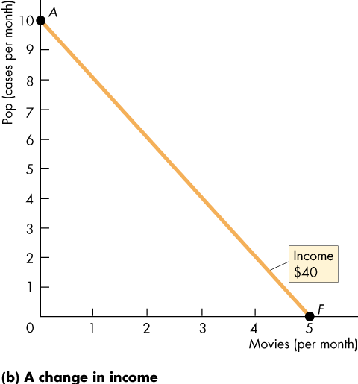
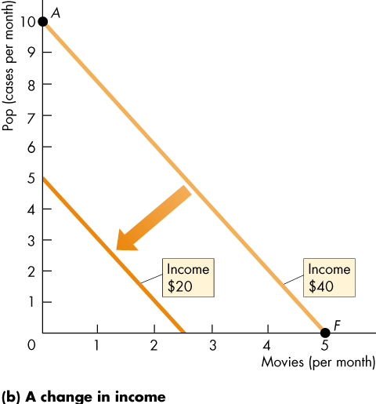
Consumption Possibilities
  A Change in Income
  A change in money income brings a parallel shift of the budget line.
  The slope of the budget line doesn’t change because the relative price doesn’t change.
  Figure 9.2(b) shows the effect of a fall in income.
Copyright © 2013 Pearson Canada Inc., Toronto, Ontario

Slide 14
Consumption Choice
Preferences
  The choice that Lisa makes depends on her preferences—her likes and dislikes.
  Lisa’s preferences can be mapped. Lisa can rank all the possible combinations of movies and cola into three groups: preferred, not preferred, and indifferent (just as good).
Copyright © 2013 Pearson Canada Inc., Toronto, Ontario

Slide 15
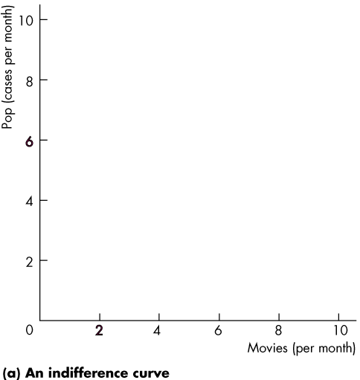
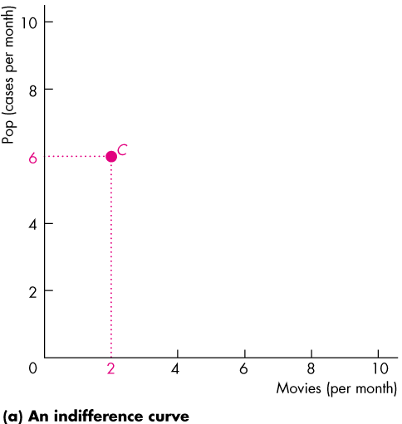
Preferences and Indifference Curves
  An indifference curve is a line that shows combinations of goods among which a consumer is indifferent.
  Figure 9.3(a) illustrates a consumer’s indifference curve.
  At point C, Lisa sees
  2 movies and drinks 6 cases of pop a month.
Copyright © 2013 Pearson Canada Inc., Toronto, Ontario

Slide 16
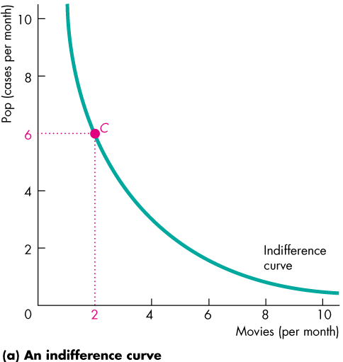
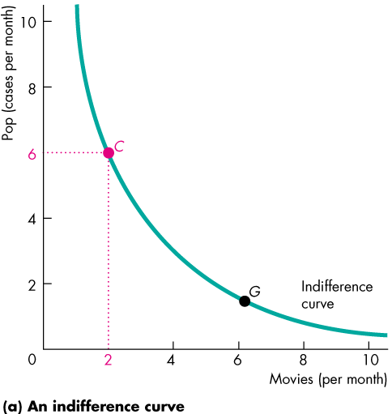
Preferences and Indifference Curves
  An indifference curve joins all those points that Lisa says are just as good as C.
  G is such a point. Lisa is indifferent between point C and point G.

Slide 17
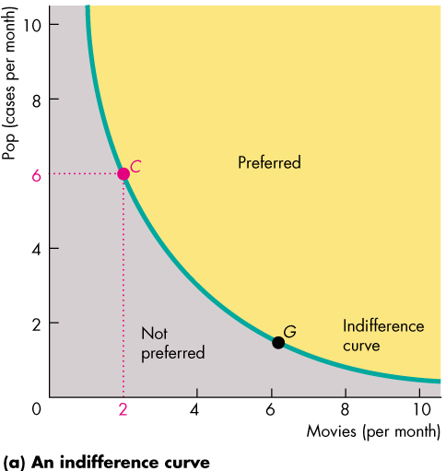
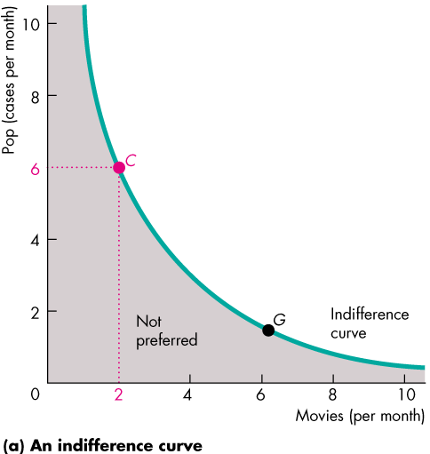
Preferences and Indifference Curves
  All the points on the indifference curve are preferred to all the points below the indifference curve.
  And all the points above the indifference curve are preferred to all the points on the indifference curve.

Slide 18
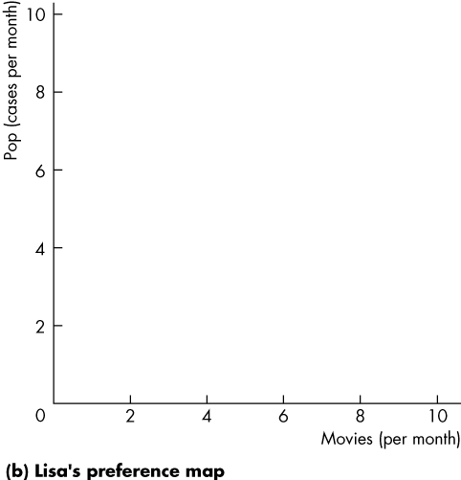
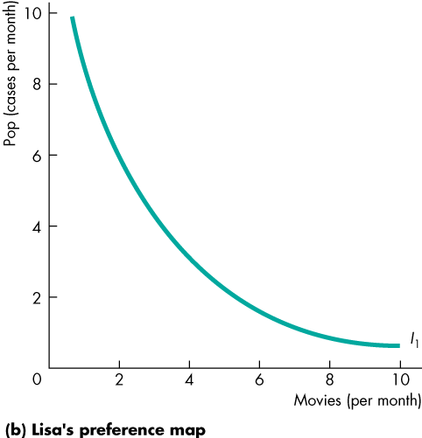
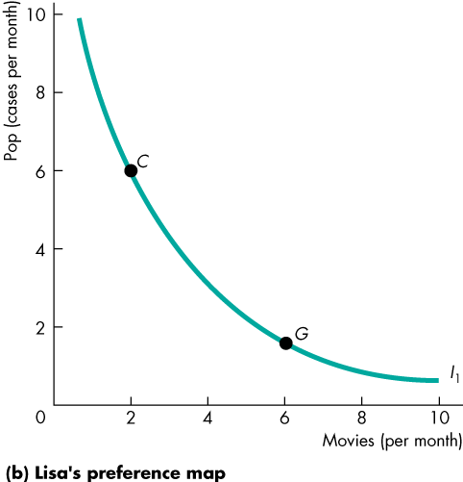
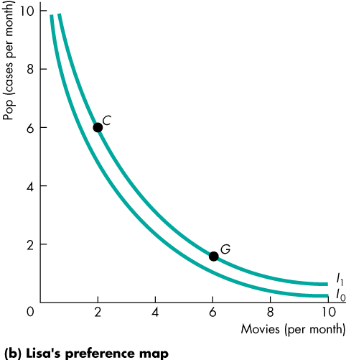
Preferences and Indifference Curves
  A preference map is a series of indifference curves.
  Call the indifference curve that we’ve just seen I₁.
  I₀ is an indifference curve below I₁.
  Lisa prefers any point on I₁ to any point on I₀ .
Copyright © 2013 Pearson Canada Inc., Toronto, Ontario

Slide 19
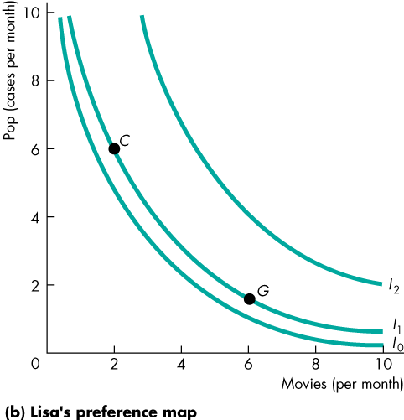
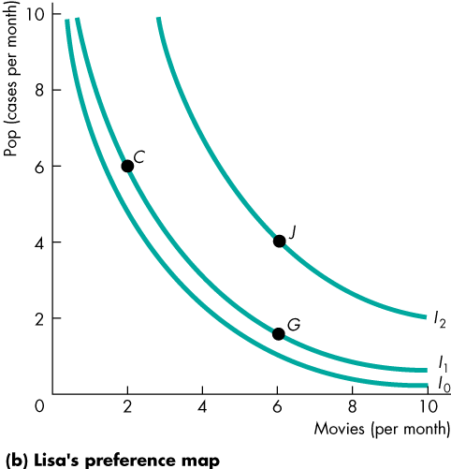
Preferences and Indifference Curves
  I₂ is an indifference curve above I₁.
  Lisa prefers any point on I₂ to any point on I₁ .
  For example, Lisa prefers point J to either point C or point G.

Slide 20
Preferences and Indifference Curves
Marginal Rate of Substitution
  The marginal rate of substitution, (MRS) measures the rate at which a person is willing to give up good y to get an additional unit of good x while at the same time remain indifferent (remain on the same indifference curve).
  The magnitude of the slope of the indifference curve measures the marginal rate of substitution.

Slide 21
Preferences and Indifference Curves
  If the indifference curve is relatively steep, the MRS is high.
  In this case, the person is willing to give up a large quantity of y to get a bit more x.
  If the indifference curve is relatively flat, the MRS is low.
  In this case, the person is willing to give up a small quantity of y to get more x.

Slide 22
Preferences and Indifference Curves
  A diminishing marginal rate of substitution is the key assumption of consumer theory.
  A diminishing marginal rate of substitution is a general tendency for a person to be willing to give up less of good y to get one more unit of good x, while at the same time remain indifferent as the quantity of good x increases.

Slide 23
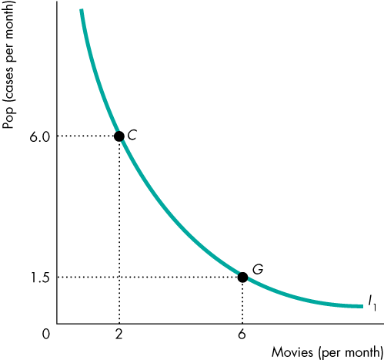
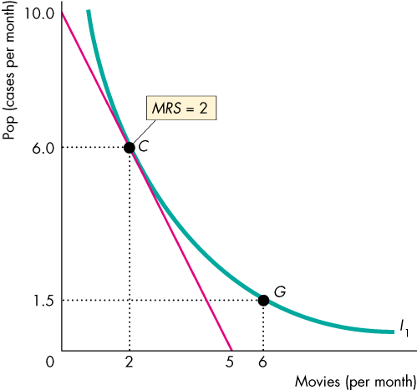
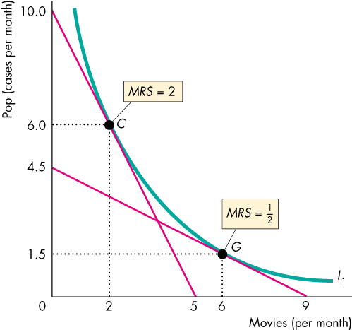
Preferences and Indifference Curves
  Figure 9.4 shows the diminishing MRS of movies for pop.
  At point C, Lisa is willing to give up 2 cases of pop to see one more movie—her MRS is 2.
  At point G, Lisa is willing to give up 1/2 case of pop to see one more movie—her MRS is 1/2.
Copyright © 2013 Pearson Canada Inc., Toronto, Ontario

Slide 24
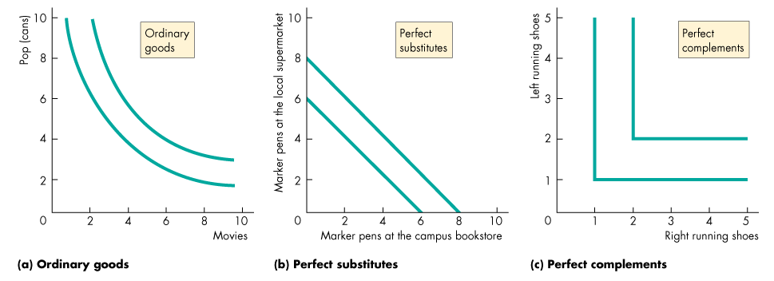
Preferences and Indifference Curves
Degree of Substitutability
  The shape of the indifference curves reveals the degree of substitutability between two goods.
  Figure 9.5 shows the indifference curves for ordinary goods, perfects substitutes, and perfect complements.
Copyright © 2013 Pearson Canada Inc., Toronto, Ontario

Slide 25
Predicting Consumer Choices
  Best Affordable Choice
  The consumer’s best affordable choice is
  On the budget line
  On the highest attainable indifference curve
  Has a marginal rate of substitution between the two goods equal to the relative price of the two goods

Slide 26
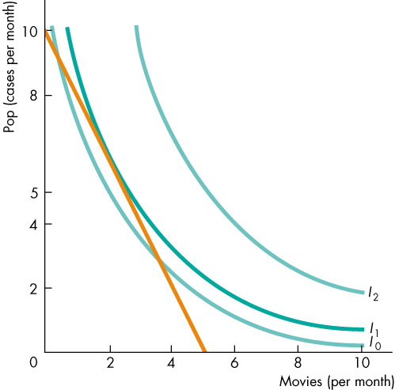
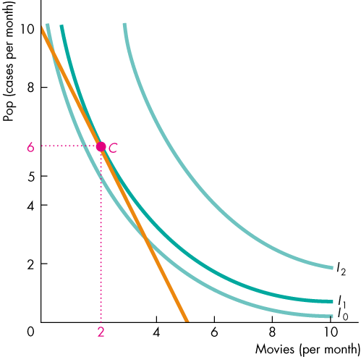
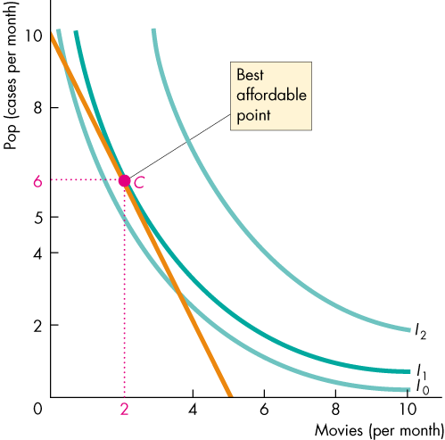
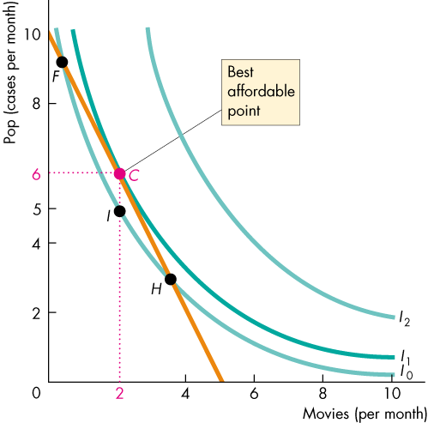
Predicting Consumer Choices
  Here, the best affordable point is C.
  Lisa can afford to consume more pop and see fewer movies at point F.
  And she can afford to see more movies and consume less pop at point H.
  But she is indifferent between F, I, and H and she prefers C to I.
Copyright © 2013 Pearson Canada Inc., Toronto, Ontario

Slide 27
Predicting Consumer Choices
  At point F, Lisa’s MRS is greater than the relative price.
  At point H, Lisa’s MRS is less than the relative price.
  At point C, Lisa’s MRS is equal to the relative price.
Copyright © 2013 Pearson Canada Inc., Toronto, Ontario

Slide 28
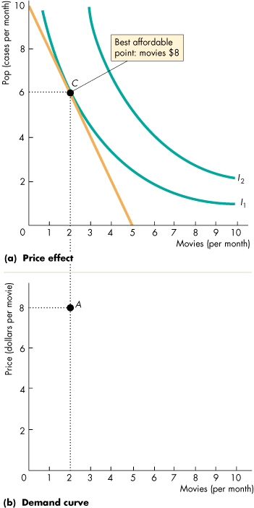
Predicting …
A Change in Price
  The effect of a change in the price of a good on the quantity of the good consumed is called the price effect.
  Figure 9.7 illustrates the price effect and shows how the consumer’s demand curve is generated.
  Initially, the price of a movie is $8 and Lisa consumes at point C in part (a) and at point A in part (b).
Copyright © 2013 Pearson Canada Inc., Toronto, Ontario

Slide 29



Predicting …
  The price of a movie then falls to $4.
  The budget line rotates outward.
  Lisa’s best affordable point is now J in part (a).
  In part (b), Lisa moves to point B, which is a movement along her demand curve for movies.
Copyright © 2013 Pearson Canada Inc., Toronto, Ontario

Slide 30

Predicting …
A Change in Income
  The effect of a change in income on the quantity of a good consumed is called the income effect.
  Figure 9.8 illustrates the effect of a decrease in Lisa’s income.
  Initially, Lisa consumes at point J in part (a) and at point B on demand curve D₀ in part (b).
Copyright © 2013 Pearson Canada Inc., Toronto, Ontario

Slide 31


Predicting …
  Lisa’s income decreases and her budget line shifts leftward in part (a).
  Her new best affordable point is K in part (a).
  Her demand for movies decreases, shown by a leftward shift of her demand curve for movies in part (b).
Copyright © 2013 Pearson Canada Inc., Toronto, Ontario

